Slide 1
Acquiring Life Cycle
Insight and Kalkulus
Tuesday, November 17, 2015

Slide 2
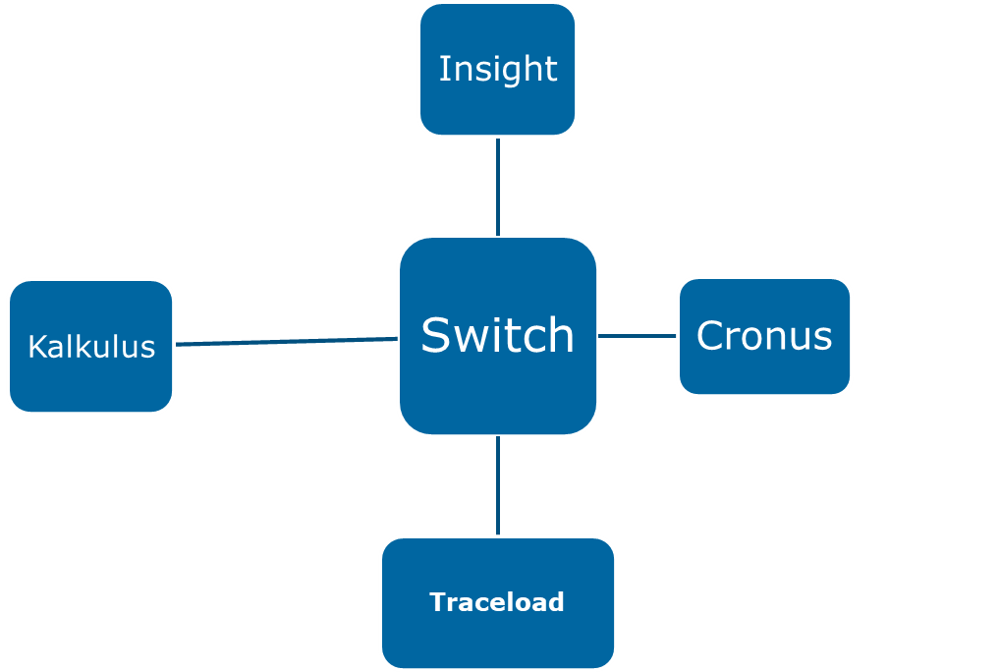
Acquiring workflow:
REV

Slide 3
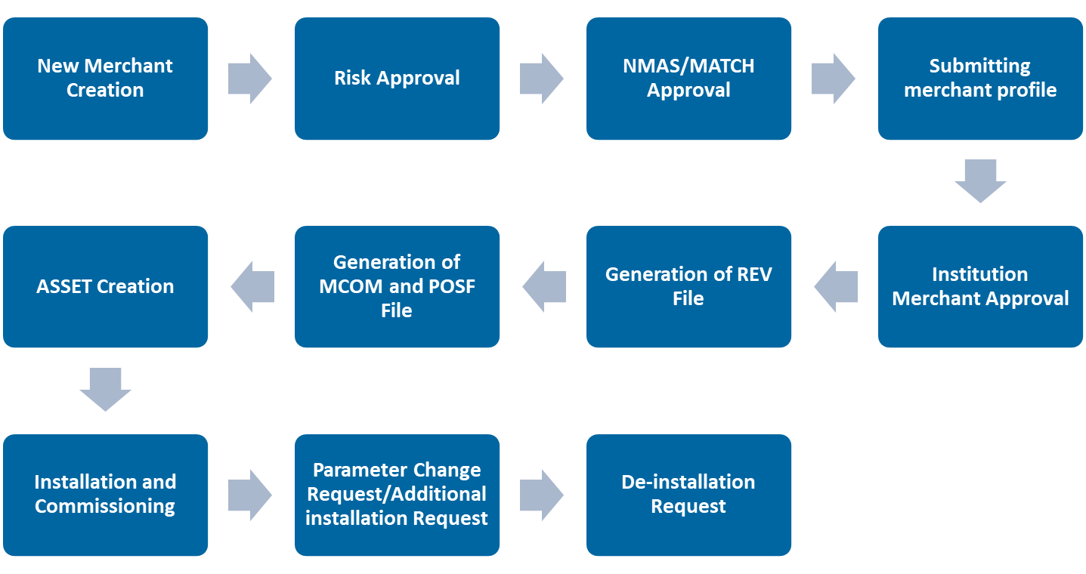
Insight workflow:
Insight is a satellite application used for managing Merchant Lifecycle.

Slide 4
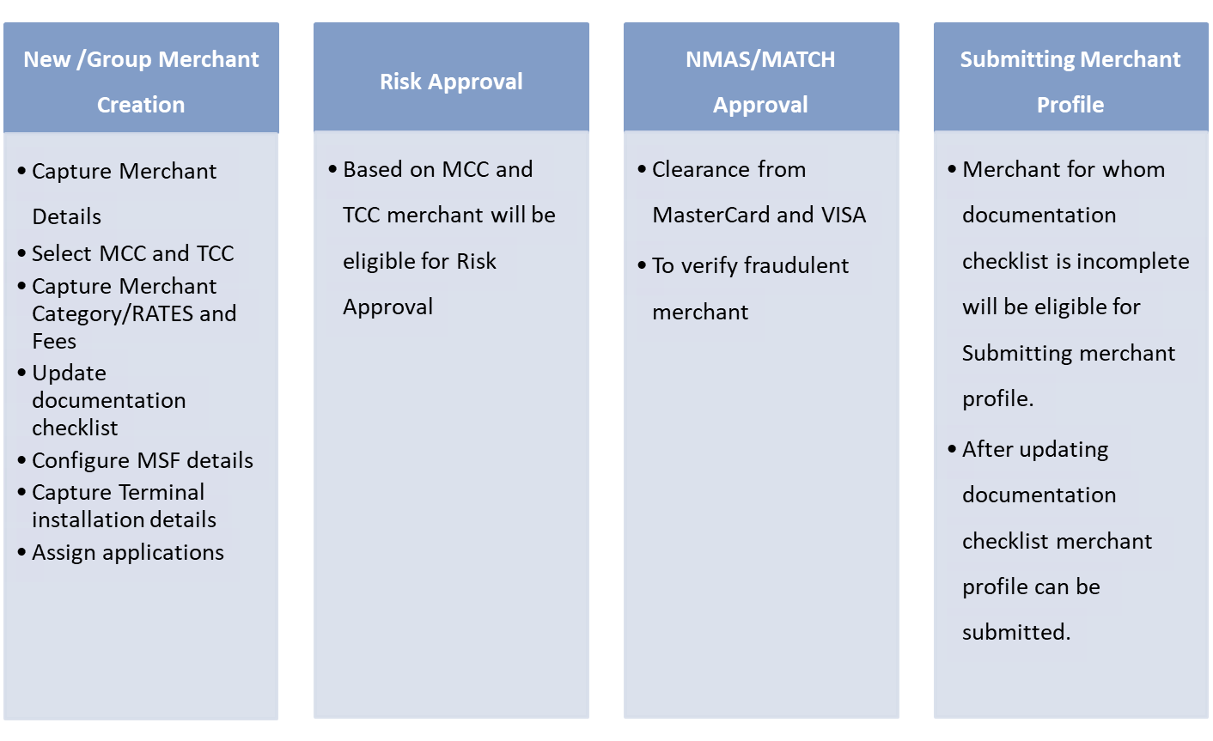
Insight Activities

Slide 5
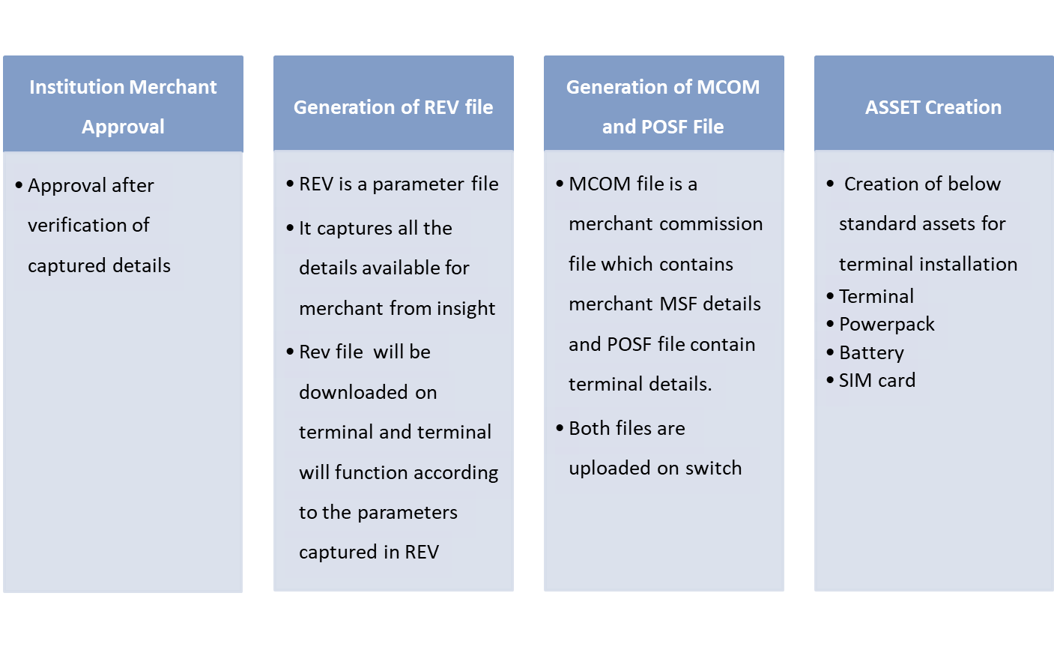
Insight Activities

Slide 6
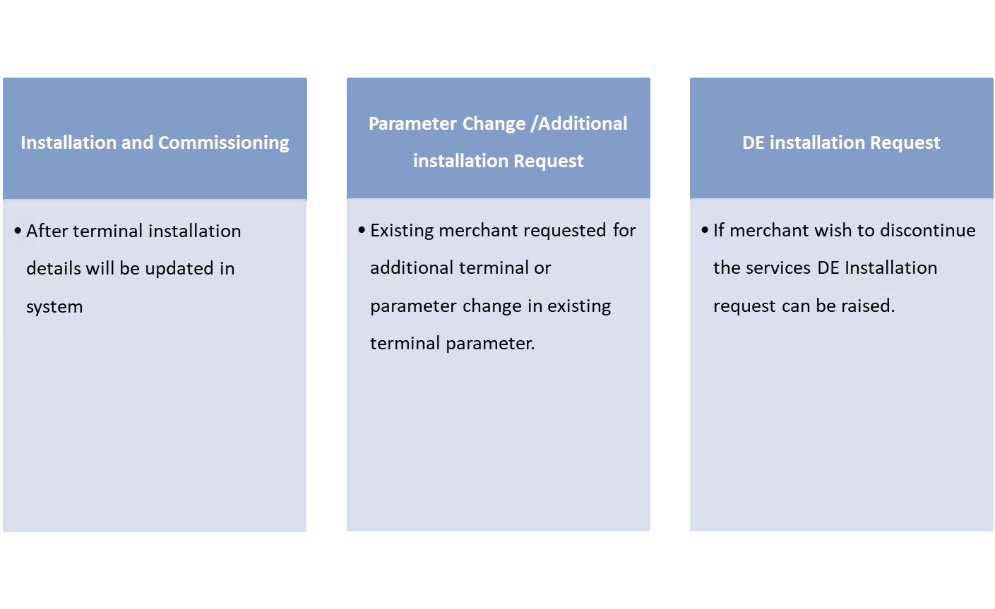
Insight Activities

Slide 7
Insight-Reports
Installations Report
De-Installation Reports
Application Activation Reports
Application Deactivation Reports
Support Management Reports
Asset Stock Transfer Summary
Asset Stock Repairing
Asset Swapping Report
REV Summary

Slide 8
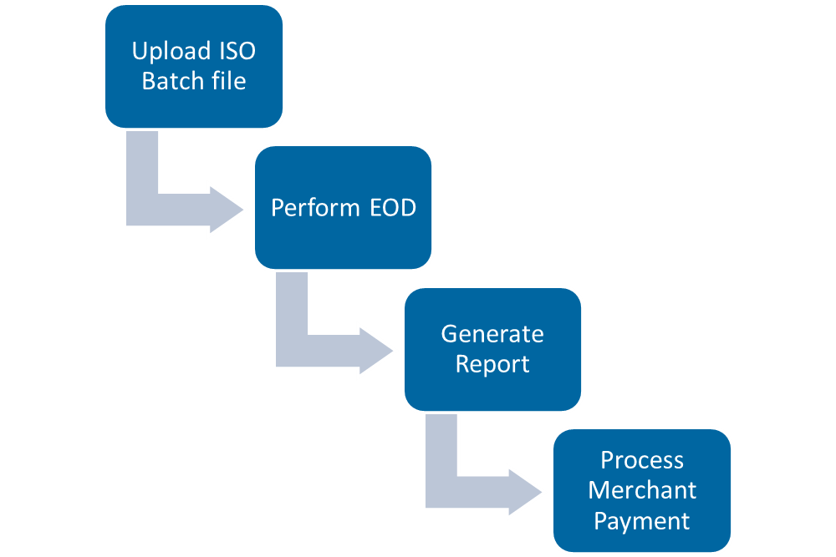
Kalkulus workflow kalkulus is a application used for settlement and processing merchant payment.

Slide 9
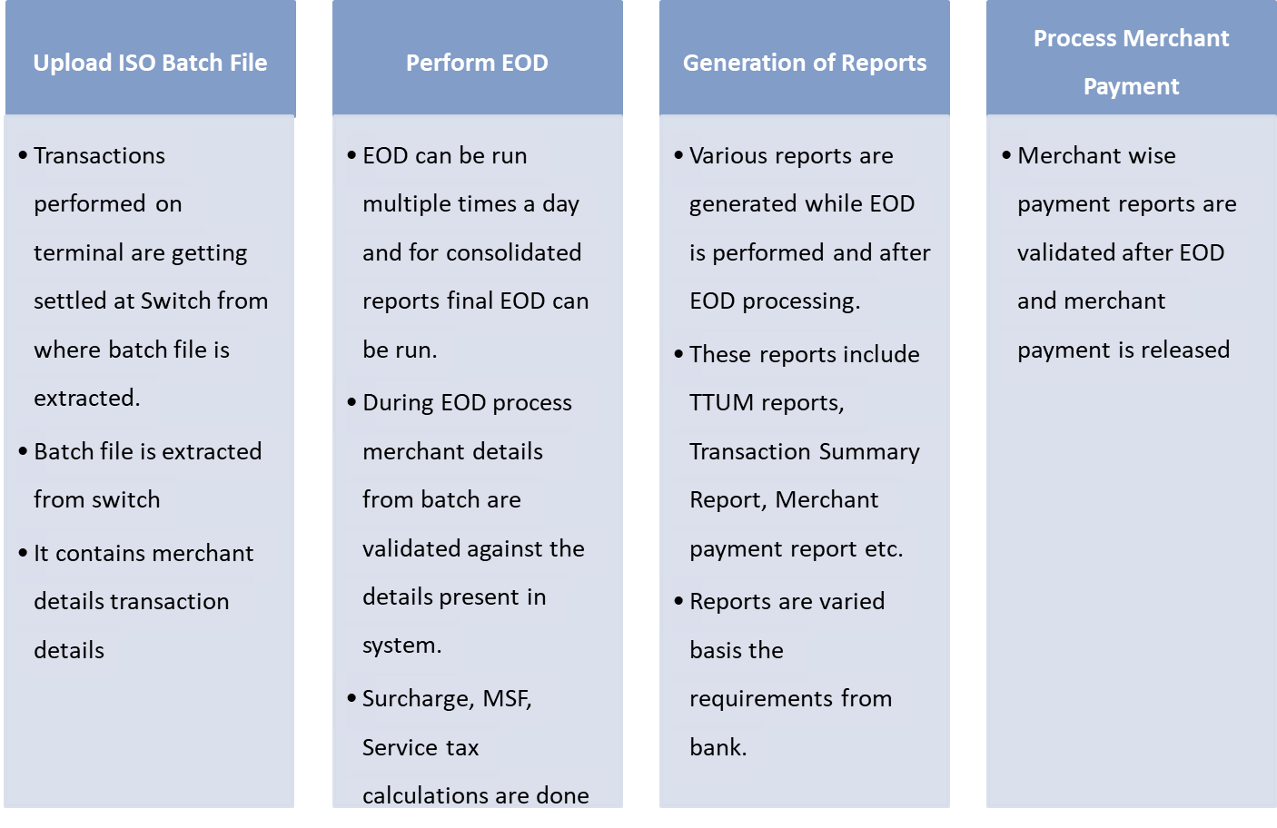
Kalkulus Activities

Slide 10
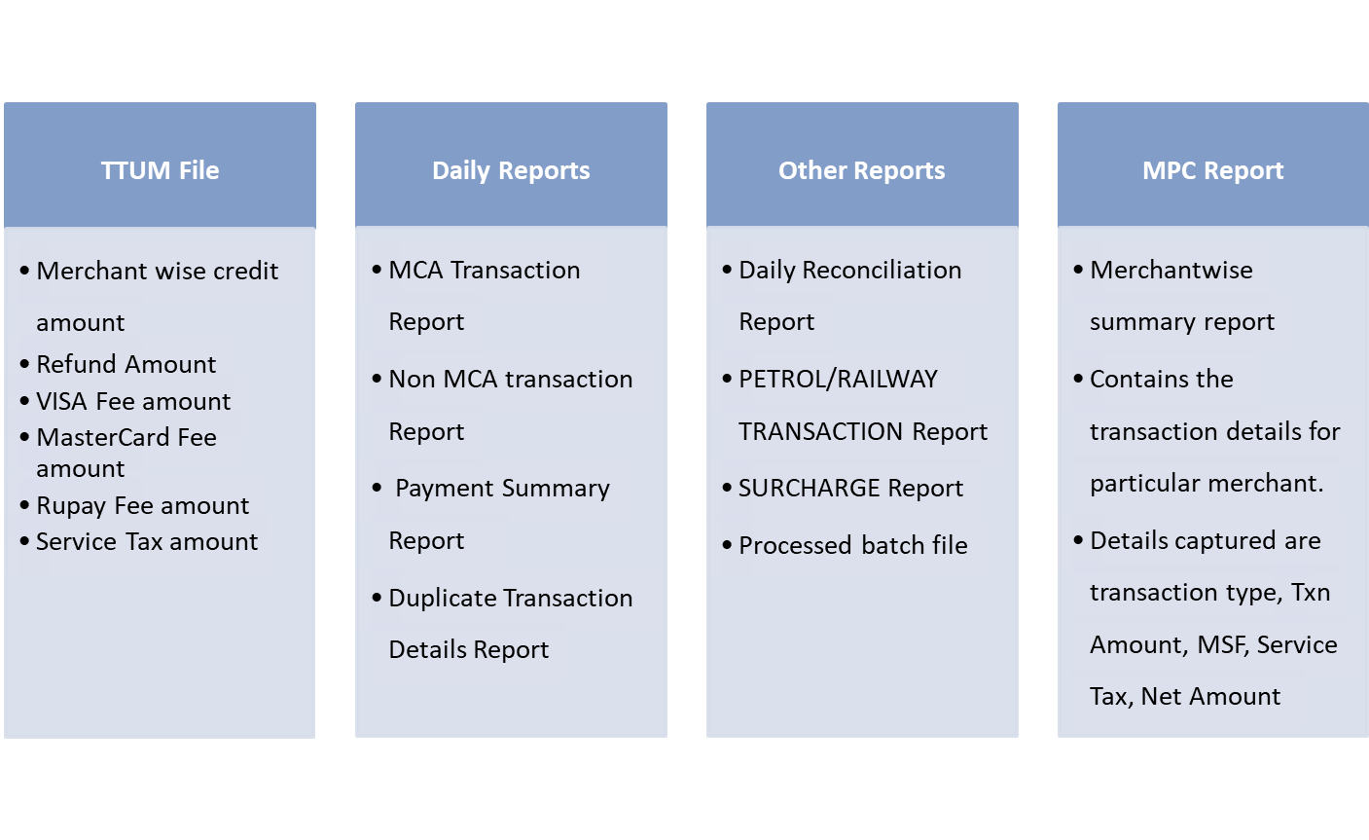
Kalkulus Reports

Slide 11
Thanks
Gaurav Patil
November 17, 2015

